Slide 1
Home Health Aid
Inservice Training
Stay Home Companions
Owner: Christine Elliott-Steve
6/1/2026

Slide 2



Introduction
Today’s training is designed to strengthen the skills, awareness, and confidence of every caregiver on our team. We will explore essential topics that support safe, ethical, compassionate, and culturally informed care for the individuals and families we serve.
As caregivers, we play a vital role in the daily lives of our clients. This training reinforces our commitment to:
Compassion
Safety
Respect
Cultural awareness
Professional excellence
Every topic we cover today is directly connected to the real‑world challenges and needs you encounter in the field.

Slide 3

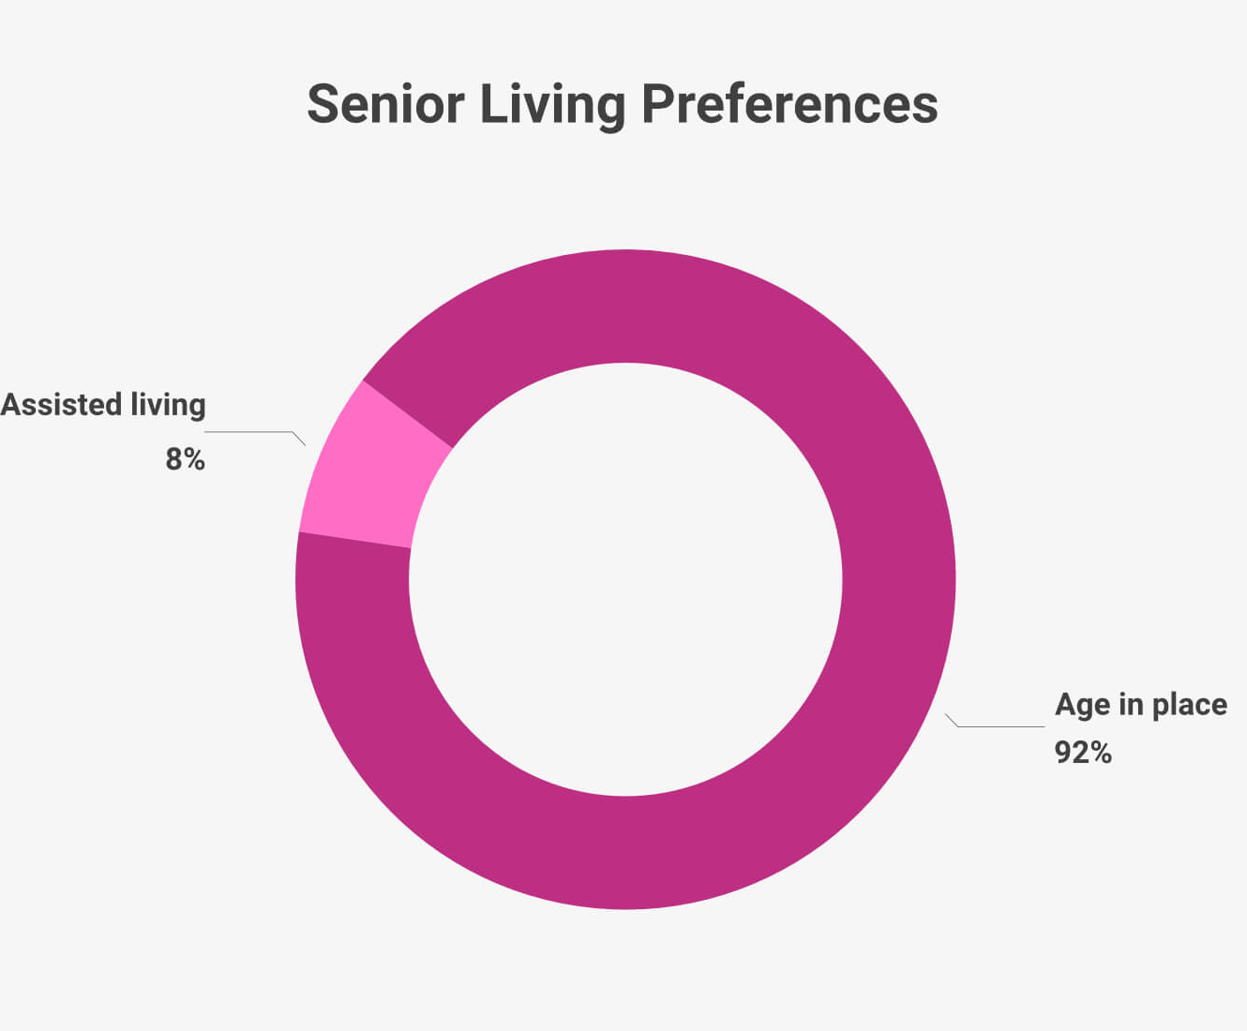


This in‑service brings together the most important areas of modern caregiving, including:
Meal Preparation & Nutrition Support
Understanding Hoarding Behaviors
Caring for Clients with Chronic Illness
Ethics & Professional Boundaries
Long‑Term Aging & Normal Aging Processes
Diversity, Equity, and Inclusion (DEI)
Recognizing & Preventing Elder Abuse
Crisis De‑Escalation Skills
Understanding Depression in Older Adults

Slide 4

Meal Preparation & Nutrition
Why Nutrition Matters
Proper nutrition supports energy, immune function, and overall well‑being
Many seniors experience reduced appetite, difficulty chewing, or dietary restrictions
Consistent, balanced meals help prevent malnutrition, dehydration, and unintended weight loss

Slide 5
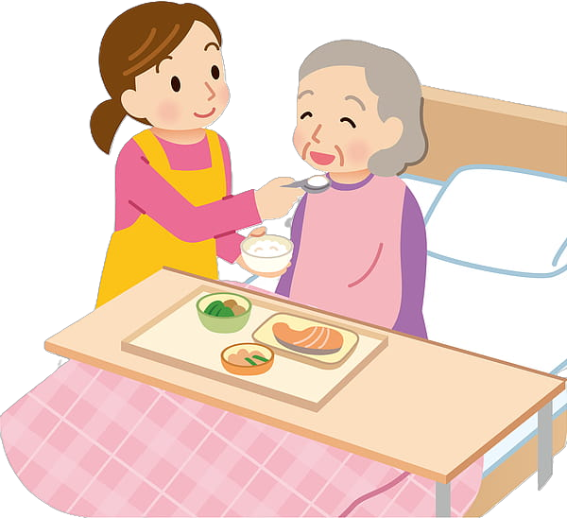
Meal Preparation & Nutrition
Key Caregiver Responsibilities
Prepare meals that are nutritious, appealing, and easy to eat
Follow all dietary guidelines (low‑sodium, diabetic‑friendly, heart‑healthy, etc.)
Monitor for changes in appetite, swallowing issues, or food avoidance
Encourage hydration throughout the day
Maintain safe food handling and proper kitchen hygiene
Best Practices for Meal Prep
Use fresh ingredients and limit processed foods
Offer small, frequent meals for clients with low appetites
Incorporate foods high in fiber, lean protein, and healthy fats
Adjust textures when needed: chopped, soft, or pureed
Make meals visually appealing to stimulate appetite
Supporting Independence & Dignity
Involve clients in simple meal decisions
Respect cultural, religious, and personal food preferences
Create a calm, pleasant mealtime environment

Slide 6

Hoarding & Supporting Clients
What Is Hoarding?
Persistent difficulty discarding possessions, regardless of value
Leads to cluttered living spaces, safety hazards, and emotional distress
Often connected to anxiety, trauma, grief, or loss of control
Not “messiness” — it is a behavioral health condition that requires patience and compassion

Slide 7

Hoarding and Support
Caregiver Role in Supporting Clients
Approach with empathy, not judgment
Build trust before addressing clutter
Encourage small, manageable steps rather than large cleanouts
Help clients identify what items matter most and why
Support decision‑making without forcing or rushing
Safe & Respectful Cleaning Practices
Prioritize safety hazards first: blocked exits, spoiled food, tripping risks
Work in small sections to avoid overwhelming the client
Offer choices: “Would you like to keep, donate, or discard this?”
Respect emotional attachments — the goal is support, not control
Maintain confidentiality and protect the client’s dignity
When to Seek Additional Help
Severe clutter that creates fire hazards, infestations, or unsafe living conditions
Signs of underlying mental health concerns (anxiety, depression, grief)
Situations requiring professional organizers, social workers, or mental health providers

Slide 8

Supporting Clients with Chronic Illness
Understanding Chronic Illness
Chronic illnesses are long‑term conditions such as diabetes, heart disease, COPD, arthritis, dementia, and autoimmune disorders
Symptoms may fluctuate, requiring flexibility and patience
Clients may experience fatigue, pain, mobility challenges, emotional stress, or medication side effects

Slide 9

Supporting Chronic Illness
Core Caregiver Responsibilities
Follow the client’s care plan, including medication reminders, diet needs, and activity guidelines
Monitor for changes in symptoms, breathing, mobility, appetite, or mood
Support daily routines that reduce stress and promote stability
Encourage safe physical activity as recommended
Communicate concerns promptly to supervisors or family
Supporting Quality of Life
Offer empathy and reassurance during difficult days
Help clients maintain independence where possible
Break tasks into manageable steps to reduce overwhelm
Provide companionship to reduce isolation and depression
Respect the client’s pace, energy level, and limitations
Promoting Safety & Prevention
Ensure proper hydration, nutrition, and medication timing
Watch for early signs of complications (e.g., swelling, shortness of breath, confusion)
Maintain a clean, clutter‑free environment to prevent falls
Use proper infection‑control practices
Emotional Support Matters
Chronic illness can bring frustration, grief, or fear
Listen without judgment
Encourage clients to express their feelings
Validate their experiences and celebrate small victories

Slide 10

Ethics and Professional Boundaries in Caregiving
Why Ethics Matter
Protects the safety, dignity, and rights of every client
Builds trust between caregivers, clients, and families
Ensures care is delivered with integrity, respect, and fairness

Slide 11

Ethics and Professional Boundaries
Core Ethical Principles
Respect — Honor client choices, privacy, and cultural values
Confidentiality — Protect personal information at all times
Autonomy — Support clients in making their own decisions
Non‑maleficence — Avoid harm through safe, responsible care
Professionalism — Maintain honesty, reliability, and accountability
Maintaining Professional Boundaries
Keep relationships supportive, not personal
Avoid sharing personal problems, opinions, or private details
Do not accept or request gifts, loans, or money
Maintain appropriate physical and emotional boundaries
Use professional communication — calm, respectful, and neutral
Common Boundary Challenges
Clients wanting to become “friends.”
Family members asking for tasks outside your role
Feeling pressured to stay late or do unpaid work
Being asked for personal contact information
Respond with kindness, clarity, and adherence to agency policies.
When to Seek Support
If a boundary feels unclear
If a client becomes overly dependent or emotionally attached
If you feel uncomfortable, pressured, or unsafe
If ethical concerns arise about another caregiver or family member

Slide 12

Long‑Term Aging & Normal Aging: How Caregivers Support Clients
Understanding Normal Aging
Aging is a natural, gradual process that affects the body, mind, and daily functioning
Common changes include slower mobility, reduced strength, changes in vision/hearing, and mild memory lapses
Emotional changes may include increased need for reassurance, routine, and connection
Normal aging is not the same as disease — it’s part of the life journey

Slide 13

Long-term and Normal Aging
Long‑Term Aging Considerations
Needs often increase over time: mobility support, nutrition, medication reminders, and safety monitoring
Chronic conditions may develop or progress, requiring consistent observation
Social isolation can become a risk without regular companionship
Maintaining dignity and independence becomes increasingly important
How Caregivers Can Support
Encourage safe independence: allow clients to do what they can, with support
Promote healthy routines: nutrition, hydration, movement, sleep, and hygiene
Use clear, calm communication and repeat information when needed
Provide patience and reassurance during moments of forgetfulness or frustration
Ensure the home environment is safe, clutter‑free, and easy to navigate
Offer meaningful companionship to reduce loneliness and support emotional well‑being
Person‑Centered Care Matters
Respect personal history, preferences, and cultural values
Adapt care to the client’s changing abilities, not the other way around
Celebrate strengths and small victories to support confidence and dignity

Slide 14

Diversity, Equity & Inclusion (DEI) in Caregiving
Why DEI Matters in Caregiving
Every client brings unique backgrounds, identities, beliefs, and life experiences
Inclusive care builds trust, comfort, and dignity
Understanding differences helps prevent misunderstandings and improves communication
DEI strengthens the caregiver‑client relationship and supports better outcomes

Slide 15

Diversity, Equity & Inclusion (DEI)
Key Principles of DEI
Diversity — Recognizing and valuing differences in culture, race, religion, gender, age, ability, and identity
Equity — Ensuring fair, individualized support based on each client’s needs
Inclusion — Creating an environment where every client feels respected, heard, and safe
Caregiver Responsibilities
Use respectful, person‑centered language
Honor cultural and religious practices (food preferences, holidays, routines)
Avoid assumptions about a client’s abilities, beliefs, or identity
Listen actively and ask when unsure — curiosity is better than guessing
Maintain professionalism even when values differ
Supporting Clients with Cultural Sensitivity
Learn about the client’s background when appropriate
Adapt care routines to align with cultural expectations
Be mindful of personal space, touch, and communication styles
Respect family dynamics and decision‑making traditions
Creating an Inclusive Care Environment
Treat every client with equal respect and compassion
Advocate for clients who may feel overlooked or misunderstood
Address bias — both conscious and unconscious — with awareness and humility
Celebrate differences as strengths, not challenges

Slide 16

Elder Abuse: Recognizing and Preventing
What Is Elder Abuse?
Elder abuse is any action or failure to act that causes harm, distress, or risk to an older adult. It can occur in homes, facilities, or community settings and may be intentional or unintentional.
Common forms include:
Physical abuse — hitting, rough handling, improper restraints
Emotional abuse — yelling, threats, humiliation, isolation
Financial exploitation — theft, scams, misuse of funds
Neglect — failing to meet basic needs (food, hygiene, safety)
Sexual abuse — any non‑consensual sexual contact
Abandonment — deserting a vulnerable adult

Slide 17

Elder Abuse- Your Duty is to Report!
Warning Signs Caregivers Should Watch For
Unexplained bruises, injuries, or repeated “accidents”
Sudden changes in mood, fearfulness, withdrawal, or anxiety
Poor hygiene, malnutrition, dehydration, or unsafe living conditions
Missing money, unpaid bills, or unusual financial activity
A caregiver or family member who is overly controlling or dismissive
Caregiver Responsibilities
Treat every client with respect, dignity, and patience
Maintain professional boundaries and avoid conflicts of interest
Document and report any suspicion of abuse immediately
Follow agency protocols and state guidelines
Support clients emotionally and reassure them they are safe
How to Respond if You Suspect Abuse
Stay calm and listen without judgment
Ensure the client is safe in the moment
Report concerns to your supervisor right away
Do not confront the suspected abuser yourself
Continue providing compassionate, consistent care
Creating a Safe Environment
Build trust through kindness and reliability
Encourage clients to speak openly about concerns
Monitor for changes in behavior or environment
Advocate for clients who cannot advocate for themselves

Slide 18

Crisis De‑Escalation for Caregivers
What Is a Crisis?
A crisis occurs when a client becomes overwhelmed, distressed, confused, or emotionally escalated, leading to behaviors such as yelling, pacing, crying, refusing care, or shutting down. Your role is to reduce tension, not to control or confront.

Slide 19
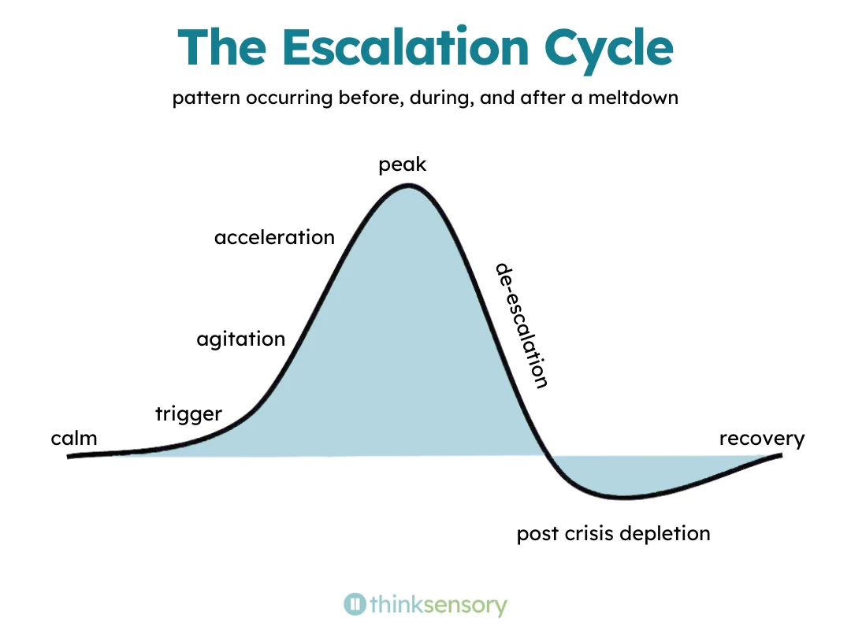
Crisis De-escalation
Core Principles of De‑Escalation
Stay calm, patient, and non‑reactive
Prioritize safety for the client and yourself
Use a soft tone, slow movements, and open body language
Focus on listening, not correcting
Give the client space and time to regain control
Effective Caregiver Strategies
Validate feelings: “I can see this is upsetting for you.”
Offer choices to restore a sense of control
Redirect gently to a calming activity or topic
Keep instructions simple and clear
Avoid arguing, raising your voice, or rushing the client
Remove triggers when possible (noise, clutter, overstimulation)
What Helps Calm a Crisis
A quiet, safe environment
Reassurance and grounding statements
Familiar routines or comforting objects
Deep breathing or slow pacing
Allowing the client to express frustration without judgment
When to Seek Additional Support
If the client becomes physically aggressive
If there is a risk of harm to self or others
If the situation continues to escalate despite your efforts
If you feel unsafe or overwhelmed
Always follow agency protocols and notify your supervisor promptly.

Slide 20

Understanding Depression in Older Adults
What Depression Looks Like in Seniors
Depression in older adults can look different than in younger people. It may appear as:
Withdrawal from activities or social interaction
Increased irritability, sadness, or hopelessness
Changes in sleep (too much or too little)
Loss of appetite or sudden weight changes
Low energy, fatigue, or slowed movement
Difficulty concentrating or making decisions
Increased complaints of pain or physical discomfort
Depression is not a normal part of aging.

Slide 21

Depression in the elderly
Common Causes & Risk Factors
Chronic illness or pain
Loss of independence or mobility
Grief, loneliness, or social isolation
Medication side effects
Major life changes (retirement, moving, loss of spouse)
Cognitive decline or early dementia
How Caregivers Can Support
Offer consistent companionship and emotional reassurance
Encourage gentle activity, fresh air, and engagement in enjoyable routines
Listen without judgment and validate feelings
Watch for changes in mood, behavior, or daily functioning
Maintain a calm, predictable environment
Report concerns promptly to supervisors or family
Support the client in staying connected with loved ones
When to Seek Additional Help
If the client expresses hopelessness or talks about giving up
If symptoms worsen or interfere with daily functioning
If you observe sudden changes in mood, appetite, or behavior
If the client appears withdrawn, fearful, or unusually tearful
Caregivers should never try to diagnose depression — but recognizing signs early can help clients get the support they need.

